Slide 1
JAVA
Unit 3(b)

Slide 2
Constructor overloading
https://www.geeksforgeeks.org/constructor-overloading-java/

Slide 3
Passing Objects in Java
Although Java is strictly pass by value, the precise effect differs between whether a primitive type or a reference type is passed.
When we pass a primitive type to a method, it is passed by value. But when we pass an object to a method, the situation changes dramatically, because objects are passed by what is effectively call-by-reference.
Java does this interesting thing that’s sort of a hybrid between pass-by-value and pass-by-reference. Basically, a parameter cannot be changed by the function, but the function can ask the parameter to change itself via calling some method within it.

Slide 4
Passing Objects in Java
While creating a variable of a class type, we only create a reference to an object. Thus, when we pass this reference to a method, the parameter that receives it will refer to the same object as that referred to by the argument.
This effectively means that objects act as if they are passed to methods by use of call-by-reference.
Changes to the object inside the method do reflect in the object used as an argument.

Slide 5
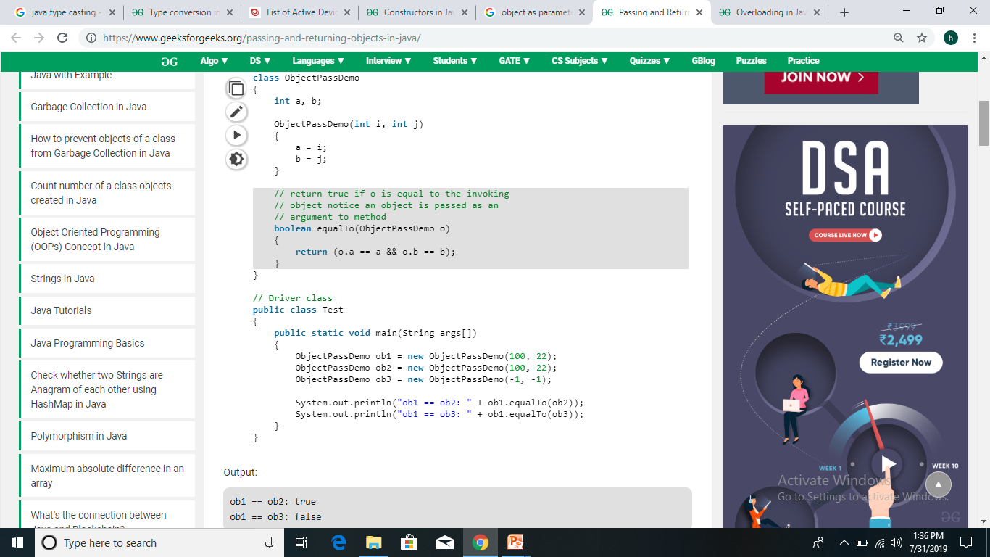

Slide 6
Java strictly Pass by value?
https://www.infoworld.com/article/3512039/does-java-pass-by-reference-or-pass-by-value.html#:~:text=Java%20always%20passes%20parameter%20variables,is%20passed%20a%20new%20value.
https://www.geeksforgeeks.org/g-fact-31-java-is-strictly-pass-by-value/

Slide 7
Access Control in Java
Access control specify what parts of a program can access the members of a class and so prevent misuse.
Java’s access modifiers are public, private, and protected. Java also defines a default access level.

Slide 8
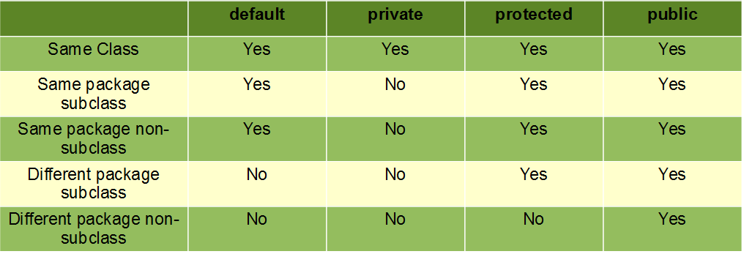
Access Control in Java

Slide 9
THIS Keyword
https://www.javatpoint.com/this-keyword

Slide 10
Other uses of ‘this’
https://www.geeksforgeeks.org/this-reference-in-java/

Slide 11
Garbage collection
https://www.guru99.com/java-garbage-collection.html

Slide 12
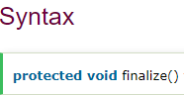
finalize() method
It is a method that the Garbage Collector always calls just before the deletion/destroying the object which is eligible for Garbage Collection, so as to perform clean-up activity.
Clean-up activity means closing the resources associated with that object like Database Connection, Network Connection or we can say resource de-allocation. Remember it is not a reserved keyword.
Once finalize method completes immediately Garbage Collector destroy that object

Slide 13
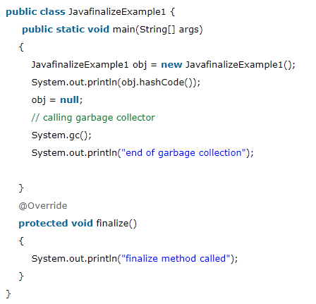

finalize() method
Output

